Slide 1
Lecture-36
Mathematics 2 (15B11MA211)
CO [C106.5]
Topic: Zeros and Singularities
References for the lecture
R.K Jain and S.R.K. Iyenger, “Advanced Engineering Mathematics” fifth edition, Narosa publishing house, 2016.

Slide 2
Topics to be covered
Zeros, Poles and Singularities
Some Remarks on Zeros, Poles and Singularities
Some Problems on Zeros, Poles and Singularities

Slide 3
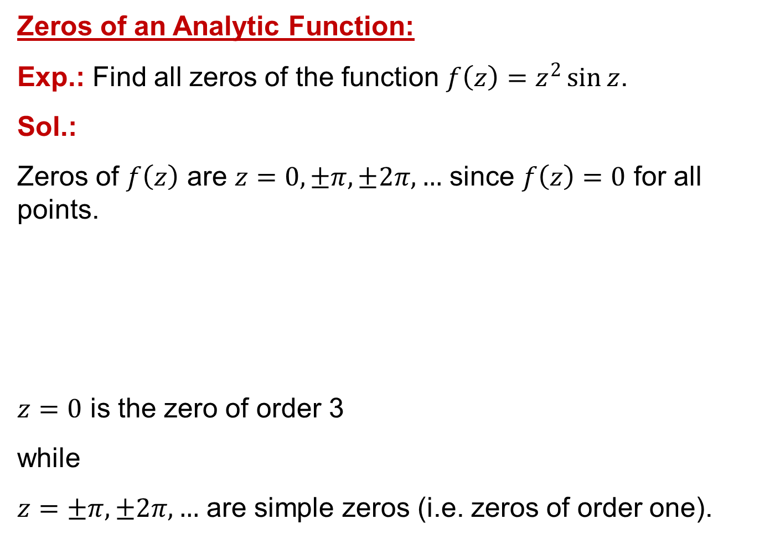
Zeros of an Analytic Function:
Exp.: Find all zeros of the function $f\left(z\right)=z^{2}\sin{z}$.
Sol.:
Zeros of $f\left(z\right)$ are $z=0, ±π, ±2π, …$ since $f\left(z\right)=0$ for all points.
$z=0$ is the zero of order 3
while
$z=±π, ±2π, …$ are simple zeros (i.e. zeros of order one).

Slide 4
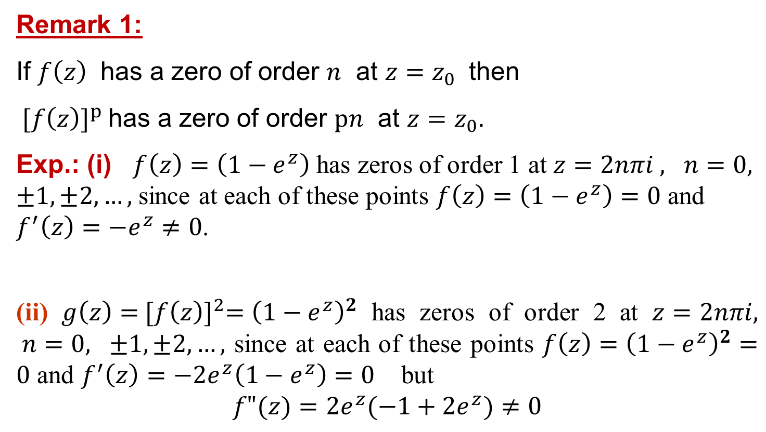
Remark 1:
If $f\left(z\right)$ has a zero of order $n$ at $z=z_{0}$ then
${ [f\left(z\right)]}^{p}$has a zero of order $pn$ at $z=z_{0}$.
Exp.: (i) $f\left(z\right)=\left(1−e^{z}\right)$ has zeros of order 1 at $z=2nπi , n=0, ±1, ±2, …,$ since at each of these points $f\left(z\right)=\left(1−e^{z}\right)=0$ and $f^{′}\left(z\right)=−e^{z}≠0$.
(ii) ${g\left(z\right)={ [f\left(z\right)]}^{2}=\left(1−e^{z}\right)}^{2}$ has zeros of order 2 at $z=2nπi, n=0, ±1, ±2, …,$ since at each of these points ${f\left(z\right)=\left(1−e^{z}\right)}^{2}=0$ and $f^{′}\left(z\right)=−2e^{z}\left(1−e^{z}\right)=0$ but
$$f"(z)=2e^{z}(−1+2e^{z})≠0$$

Slide 5
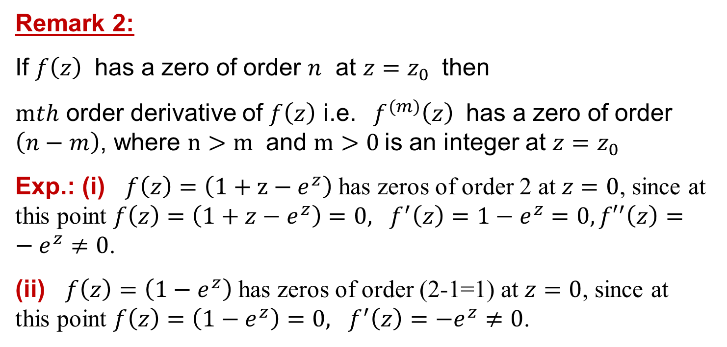
Remark 2:
If $f\left(z\right)$ has a zero of order $n$ at $z=z_{0}$ then
$mth$ order derivative of $f\left(z\right)$ i.e. ${ f}^{(m)}\left(z\right)$ has a zero of order $\left(n−m\right)$, where $n>m$ and $m>0$is an integer at $z=z_{0}$
Exp.: (i) $f\left(z\right)=\left(1+z−e^{z}\right)$ has zeros of order 2 at $z=0$, since at this point $f\left(z\right)=\left(1+z−e^{z}\right)=0, f^{′}\left(z\right)=1−e^{z}=0,{f′}^{′}\left(z\right)=−e^{z}≠0\text{.}$
(ii) $f\left(z\right)=\left(1−e^{z}\right)$ has zeros of order (2-1=1) at $z=0$, since at this point $f\left(z\right)=\left(1−e^{z}\right)=0, f^{′}\left(z\right)=−e^{z}≠0\text{.}$

Slide 6
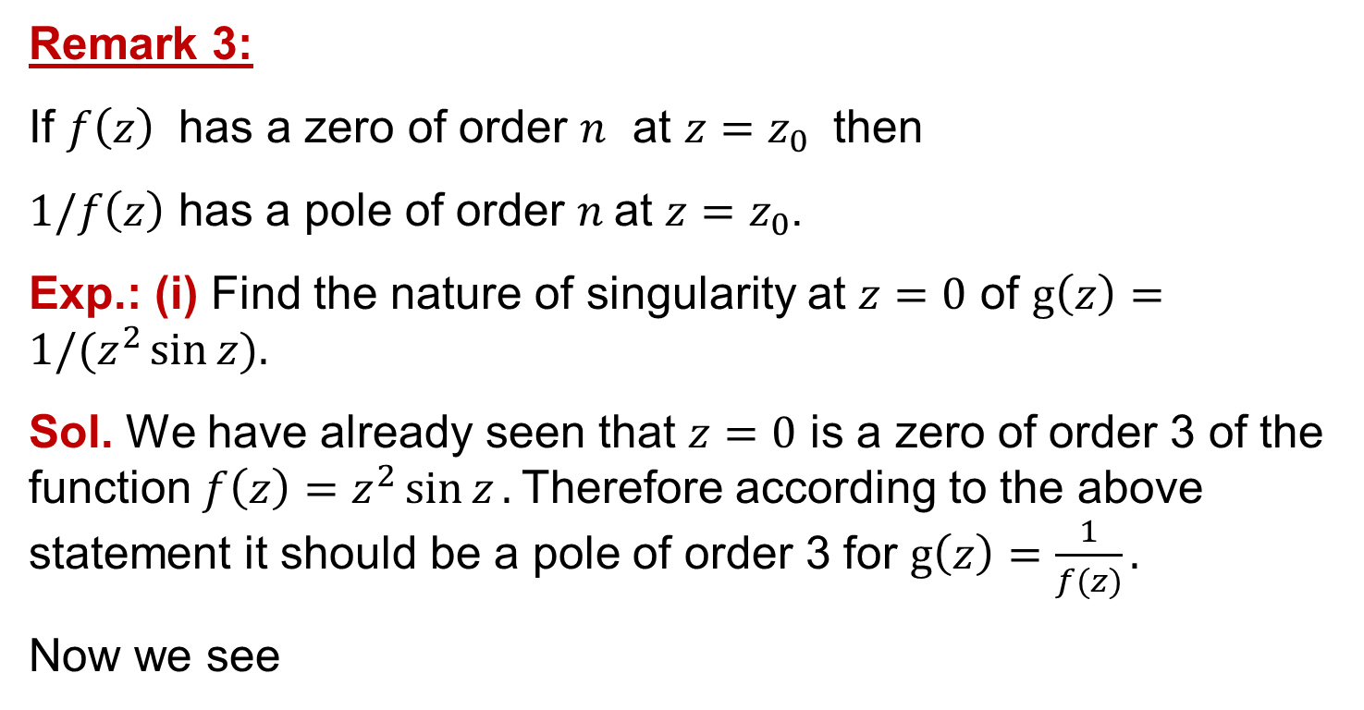
Remark 3:
If $f\left(z\right)$ has a zero of order $n$ at $z=z_{0}$ then
$1/f\left(z\right)$ has a pole of order $n$at $z=z_{0}$.
Exp.: (i) Find the nature of singularity at $z=0$ of $g\left(z\right)={1/(z}^{2}\sin{z}).$
Sol. We have already seen that $z=0$ is a zero of order 3 of the function$f\left(z\right)=z^{2}\sin{z}.$ Therefore according to the above statement it should be a pole of order 3 for $g\left(z\right)=\frac{1}{f(z)}.$
Now we see

Slide 7
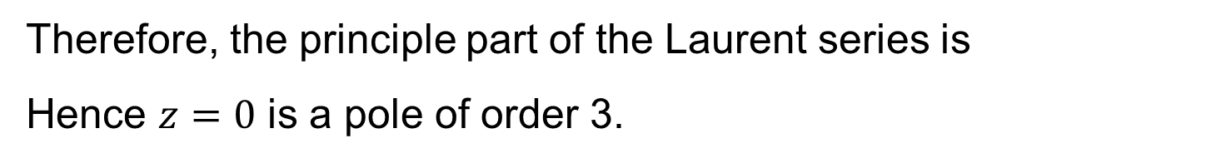
Therefore, the principle part of the Laurent series is
Hence $z=0$ is a pole of order 3.

Slide 8
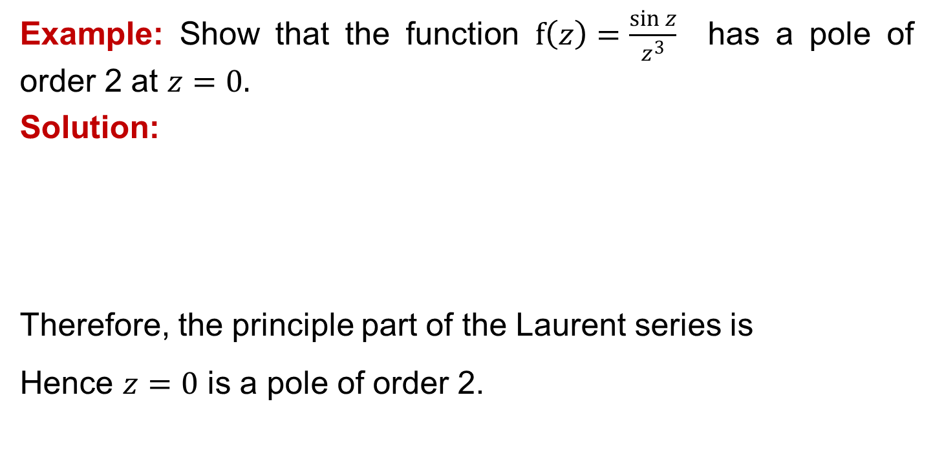
Example: Show that the function $f\left(z\right)=\frac{\sin{z}}{z^{3}}$ has a pole of order 2 at $z=0.$
Solution:
Therefore, the principle part of the Laurent series is
Hence $z=0$ is a pole of order 2.

Slide 9
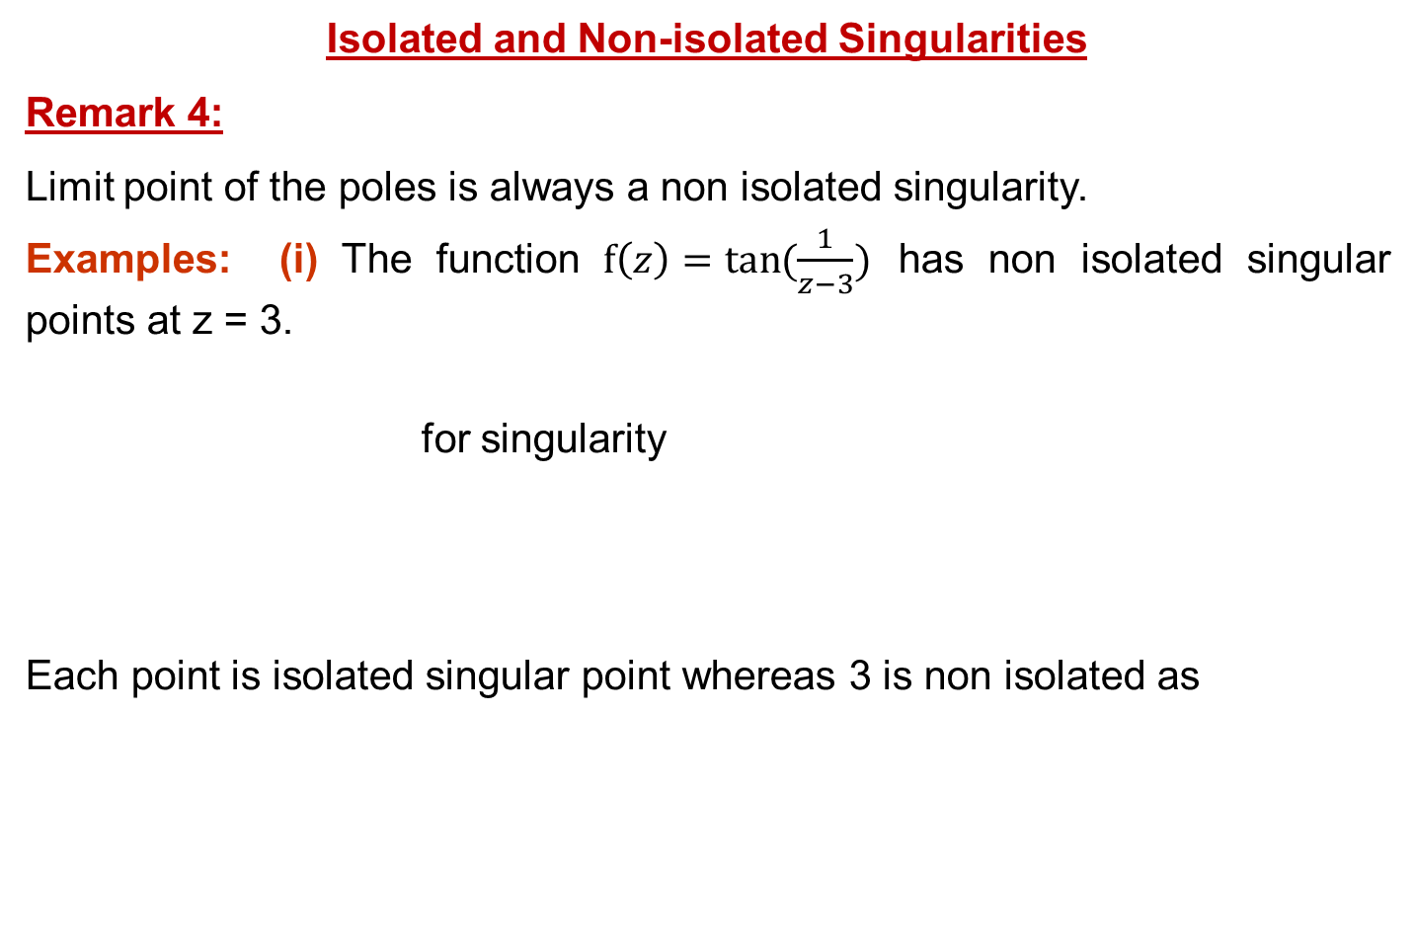
Isolated and Non-isolated Singularities
Remark 4:
Limit point of the poles is always a non isolated singularity.
Examples: (i) The function $f\left(z\right)=\tan{(\frac{1}{z−3})}$ has non isolated singular points at z = 3.
for singularity
Each point is isolated singular point whereas 3 is non isolated as

Slide 10
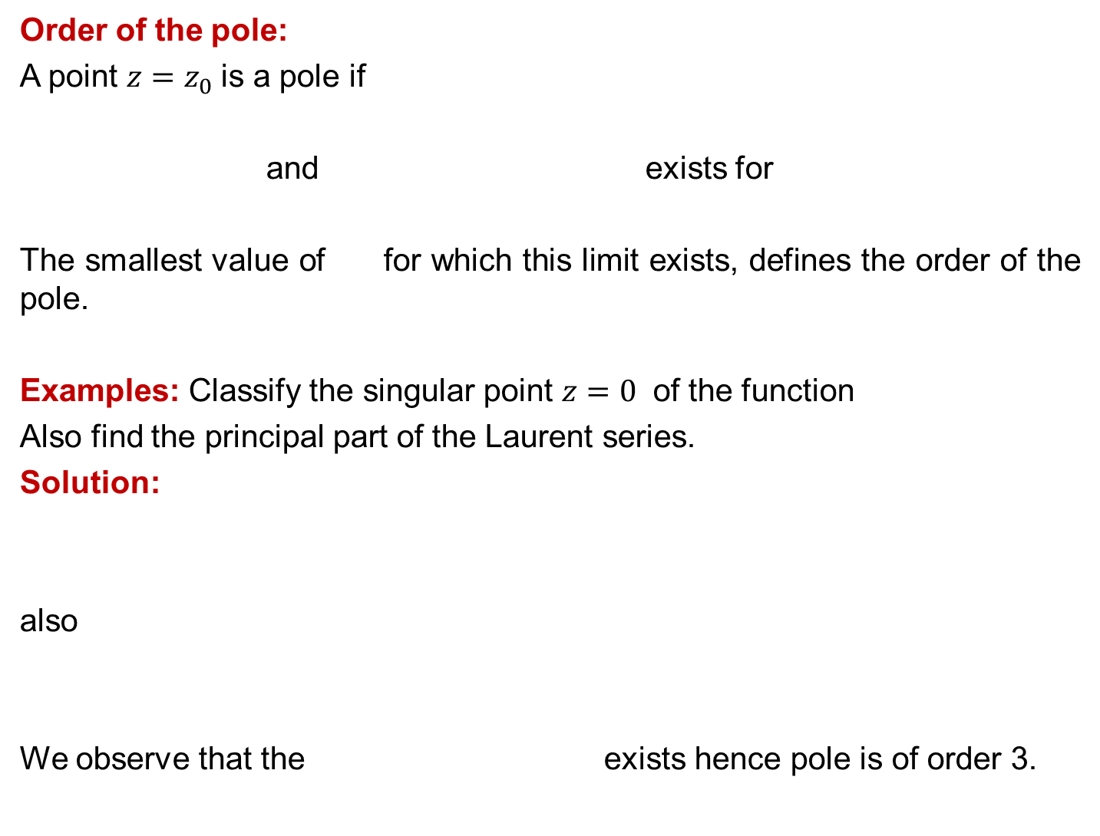
Order of the pole:
A point $z=z_{0}$is a pole if
and exists for
The smallest value of for which this limit exists, defines the order of the pole.
Examples: Classify the singular point $z=0$ of the function
Also find the principal part of the Laurent series.
Solution:
also
We observe that the exists hence pole is of order 3.

Slide 11

Therefore, the principle part of the Laurent series is
Hence $z=0$ is a pole of order 3.

Slide 12
Thank You

